Slide 1

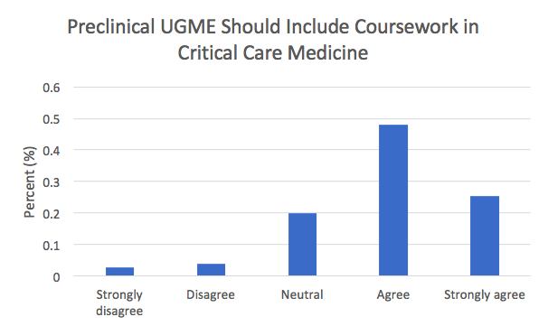
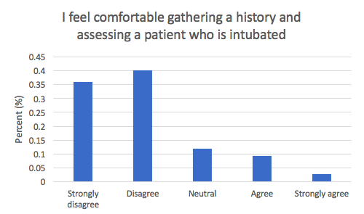
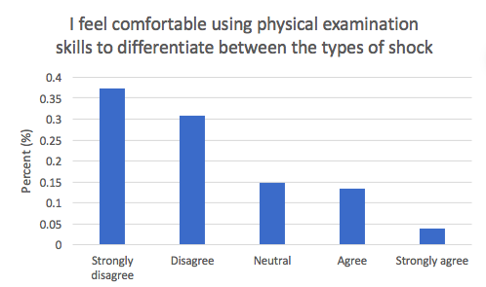
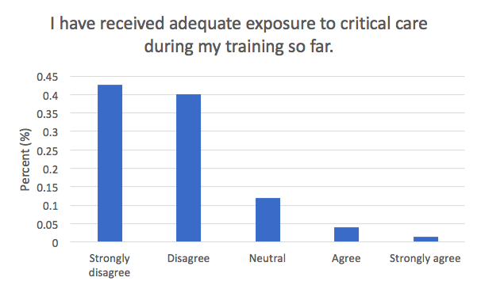
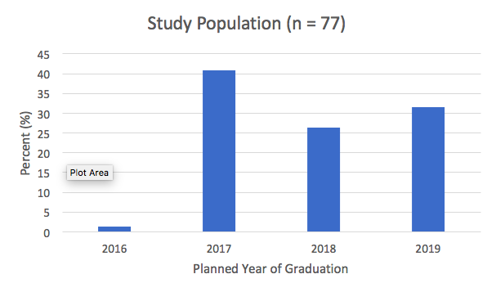
Medical Student Perspectives on the Need for Pre-Clinical Education in Critical Care Medicine
Nicholas Montano MSIV, Samuel Clarke MD, Ian Julie MD, Aaron Danielson MD
Background
Critical care skills are vital for patient care. Current research shows that graduating medical students and residents are inadequately prepared for their role taking care of these patients. Past research has focused on faculty beliefs about required critical care clinical skills and gaps in training. However, there has been no research to date evaluating medical students’ perspectives on the need for education in critical care medicine.
Study Objective
Assess medical students’ perspectives on the need for pre-clinical education in critical care medicine
Results
77 Medical students participated in this study, resulting in an 18% response rate. Students agree that pre-clinical medical education should include coursework in critical care medicine (3.89, [3.682-4.098]). Pre-clinical students felt significantly less comfortable than clinical medical students in all domains (p<0.05) and, despite their relative level of comfort, clinical medical students still felt inadequately exposed to critical care (1.81, [1.609-2.011]).
Methods
Voluntary, anonymous, online surveys were distributed to UC Davis medical students during the 2015-16 academic year. Survey questions were 5 point Likert scale style, and the results were reported as (mean, 95% confidence interval)
Discussion
In this single-center survey, we found that pre-clinical and clinical medical students are aware of the need for critical care skills and are interested in obtaining them. These data support the existing body of literature showing that current critical care training is inadequate. Limitations of this study include a low response rate and a single-center site.
References
Buchman, T.G., et al., Undergraduate education in critical care medicine. Crit Care Med, 1992. 20(11): p. 1595-603.
Harrison, G.A., et al., The need for undergraduate education in critical care. (Results of a questionnaire to year 6 medical undergraduates, University of New South Wales and recommendations on a curriculum in critical care).Anaesth Intensive Care, 1999. 27(1): p. 53-8.
Smith, C.M., et al., Undergraduate training in the care of the acutely ill patient: a literature review. Intensive Care Med, 2007. 33(5): p. 901-7.
Notes:
I changed the wording of the background to make it more clear.
For the Problem section, are you referring to UCD students specifically, or medical students in general? (I’m guessing both, but the positioning of the references suggests the latter). You might make a 3rd bullet point with these references suggesting that it is a problem for medical students in general.
AD: I added in the extra bullet to try to clarify
For the theoretical framework, I’m in agreement with your choice. The table is nice, but I still think it is too visually similar to the one at the center of the table (in my version they also overlap, and it cuts part of the theoretical framework table off). You could probably shrink it this table, and I would at least choose different colors to set it off a bit more.
AD I changed the color and shrunk the table. They do not overlap in my version. Do they still overlap in yours?
New images: I like the simplified pyramid. Be sure that the resolution is the same for the figures as it is for the rest of the poster (if the figures are lower resolution they get hazy when blown up, which looks tacky). For the diagram of the patient, I like the touch of color. You might consider expanding the green and red circles (maybe making them rectangles) and listing the components of those two cluster exams inside them to drive home the idea. Or just keep the colored lettering and make two vertical lists of the Pulm and CV clusters where the circles currently are.
AD Changed as you recommended. Also confirmed that all parts of the poster are the same resolution.

