Slide 1
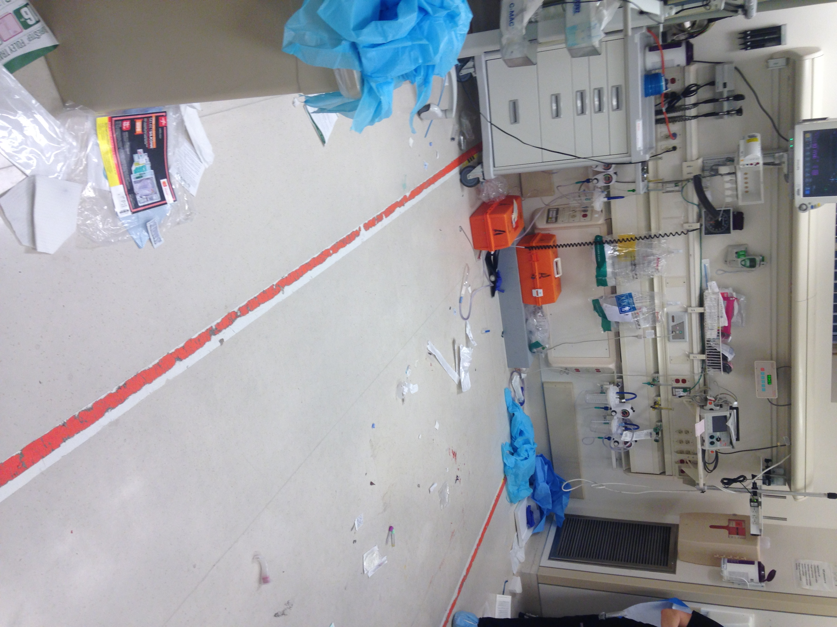
Focus on
POCUS
Pilot Longitudinal Elective
for Senior Medical Students
Montano NM, Medeiros SE, Schick MA

Slide 2

No Financial coi to disclose
Breaking Bad (2008-2013)

Slide 3
Background

Slide 4

Medical Students with ultrasound
SOME

Slide 5


Slide 6
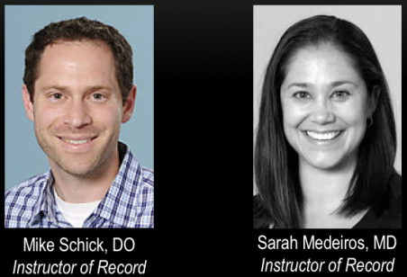
“We have an idea…”

Slide 7
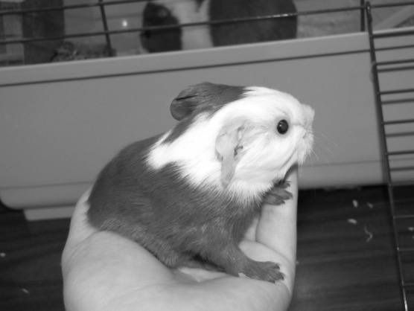
First, we’ll need a
Guinea
Pig
4th year medical student interested in emergency ultrasound
Thebennettzoo.com

Slide 8
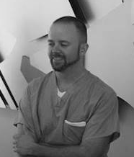
Guinea
Pig
4th year medical student interested in emergency ultrasound
Thebennettzoo.com

Slide 9
METHODS

Slide 10
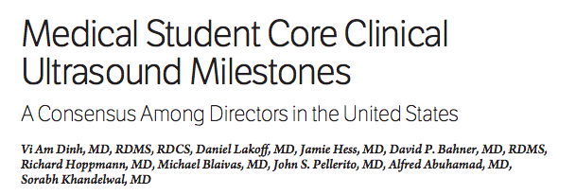
#1
Journal of Ultrasound in Medicine, Feb-2016
Our objective was to
achieve the 90 milestones
Ref. ***

Slide 11
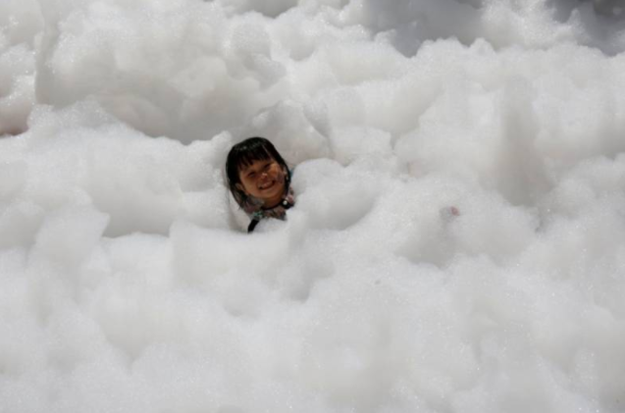
Didactics
Let’s design the didactic part using FOAM content

Slide 12





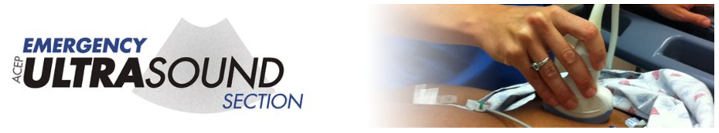
(150 hrs)

Slide 13
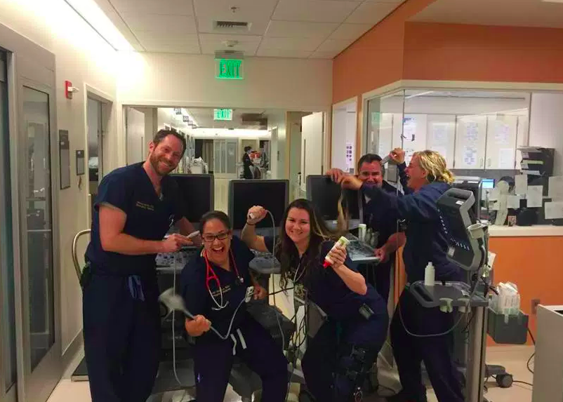
Clinical
(My Ultrasound Mentors)

Slide 14
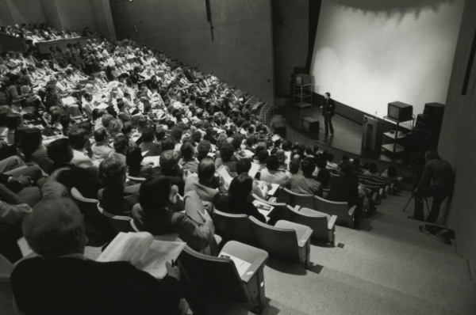
Teaching

Slide 15
Results

Slide 16
Academic Hours
Didactic 150
Clinical 500
Teaching 100
Total Hours 750

Slide 17
US Scans
ED (UC Davis) 500*
ED (off-site) 250
Off-service 50
Total Scans 800
*UC Davis ED scans reviewed and discussed with Ultrasound Faculty

Slide 18


Did they ever achieve the core clinical milestones?

Slide 19
Did they ever achieve the core clinical milestones?
Completed

Slide 20
Discussion

Slide 21
Dedicated
Students
Dedicated
Faculty

Slide 22
Focus on
POCUS
Pilot Longitudinal Elective
for Senior Medical Students
Montano NM, Medeiros SE, Schick MA

